Slide 1
LLMs in Practice:
Quantisation
W10 L2
Russel Dsouza / 2025-03-27

Slide 2
Recap
NLP so far
The Transformer model
The Language Modelling task
The Pre-train & Fine-tune paradigm
RL-based Instruction tuning with human feedback
Scaling to a Trillion parameters with scaling laws

Slide 3
How do I train my LLM on a toaster?
Today we’ll see how to:
Reduce memory footprint with quantisation
Build a toaster-friendly SOTA LLM from scratch in JAX

Slide 4
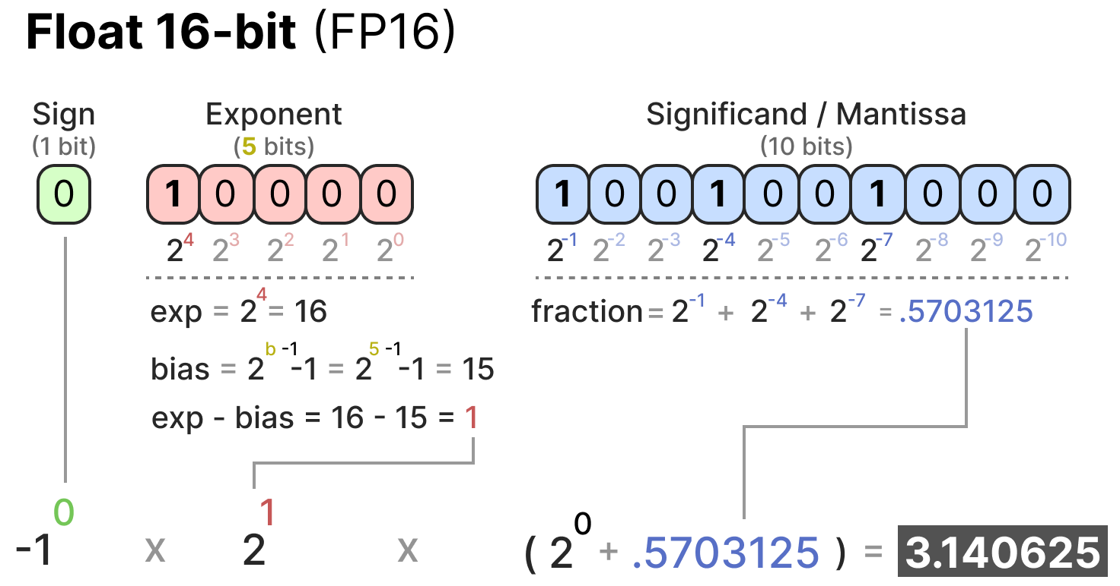
How to represent numerical values?
Because computers are not humans
The IEEE-754 standard describes how numbers are represented
https://newsletter.maartengrootendorst.com/p/a-visual-guide-to-quantization

Slide 5
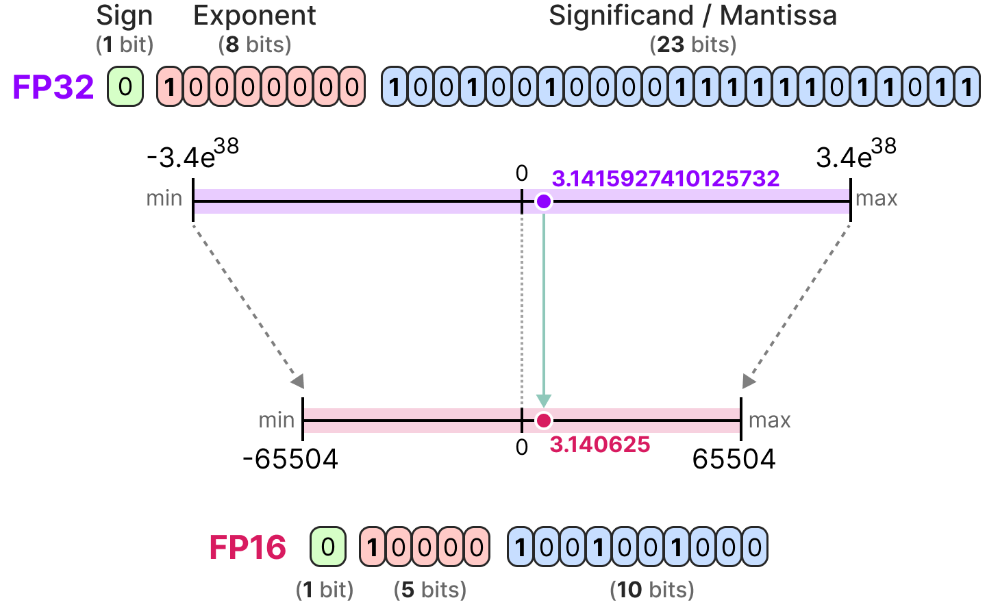
Quantisation
FP16
https://newsletter.maartengrootendorst.com/p/a-visual-guide-to-quantization

Slide 6
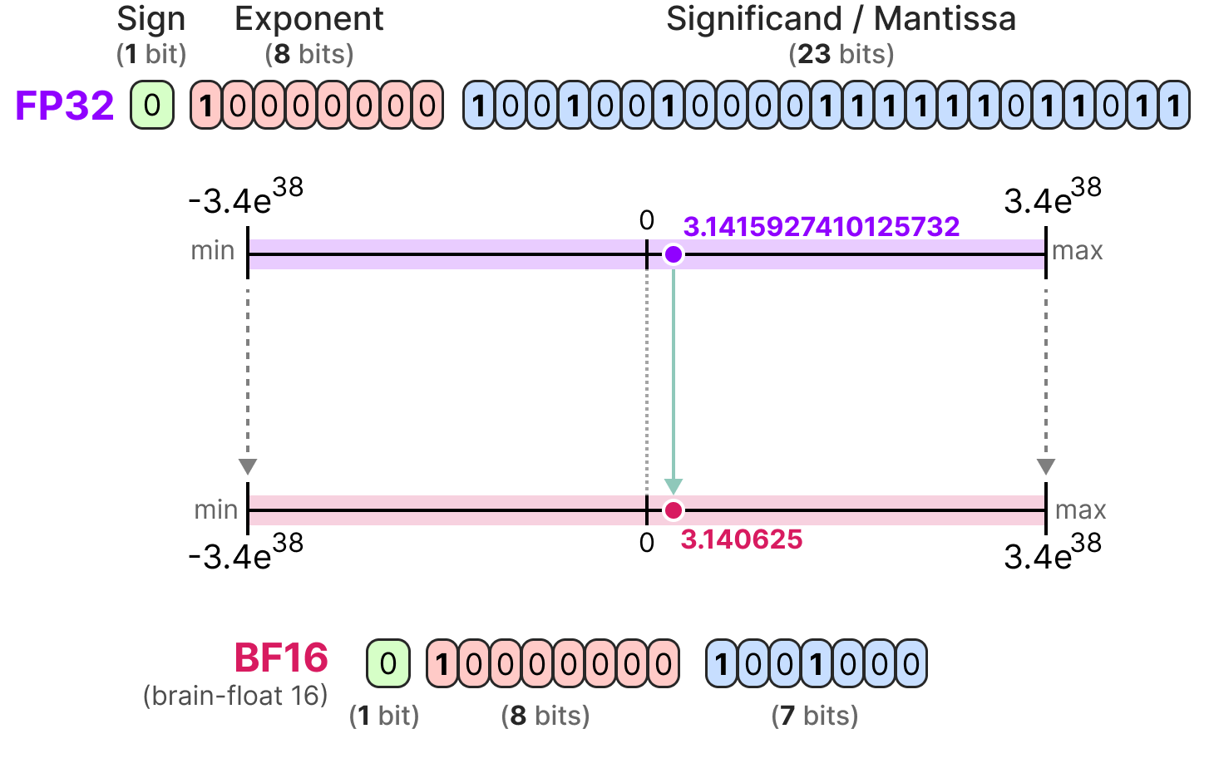
Quantisation
BF16
https://newsletter.maartengrootendorst.com/p/a-visual-guide-to-quantization

Slide 7
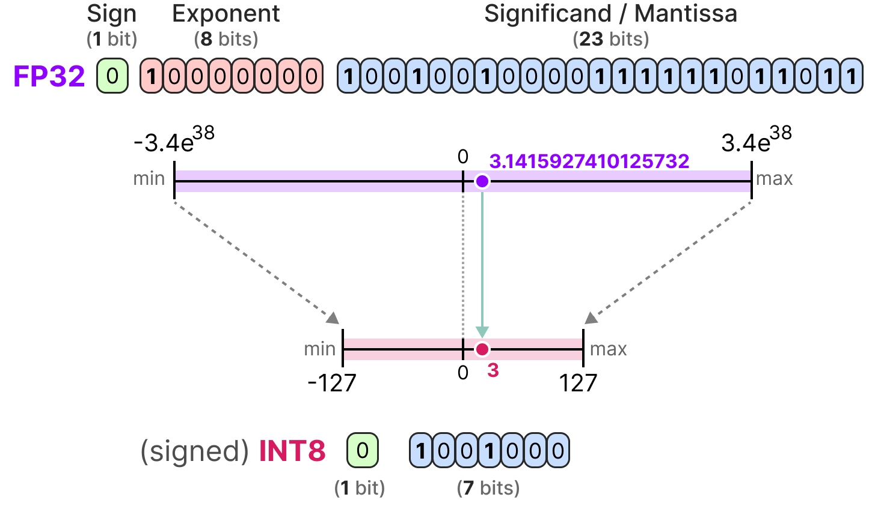
Quantisation
INT8
https://newsletter.maartengrootendorst.com/p/a-visual-guide-to-quantization

Slide 8
Quantisation
Challenges
Reduces memory, but:
Degrades performance
Usually requires tuning quantisation further after training
Studied only for models with less than 350M parameters

Slide 9
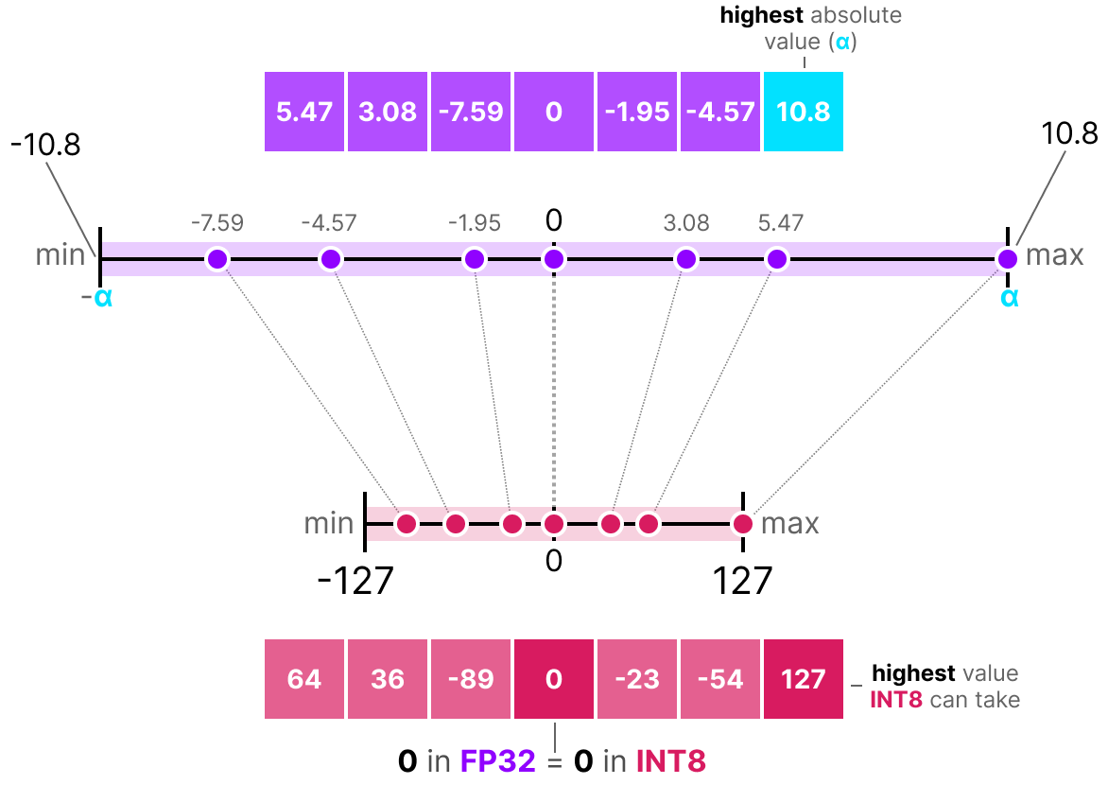
Quantisation
Abs-max
https://newsletter.maartengrootendorst.com/p/a-visual-guide-to-quantization

Slide 10
Quantisation
Abs-max: Limitations
A single outlier can reduce the quantisation precision of other values.

Slide 11
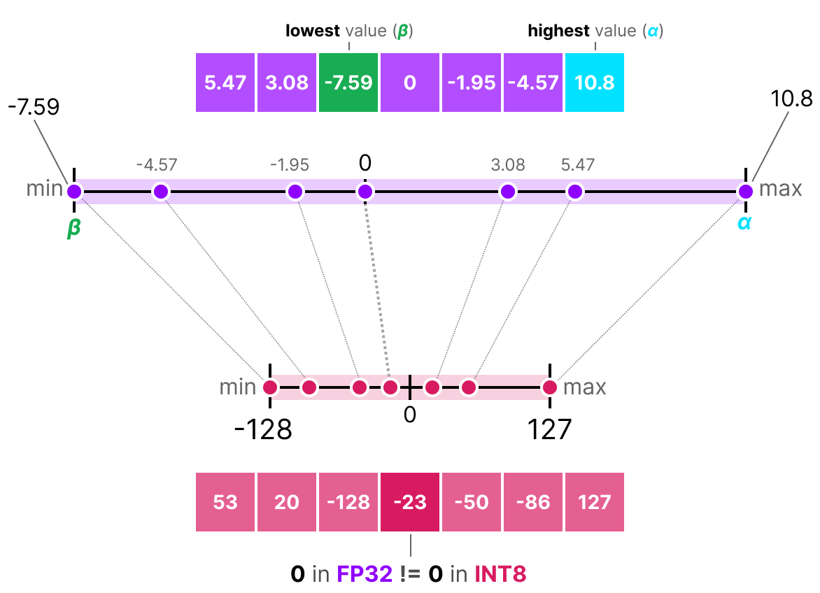
Quantisation
Zero-point
https://newsletter.maartengrootendorst.com/p/a-visual-guide-to-quantization

Slide 12
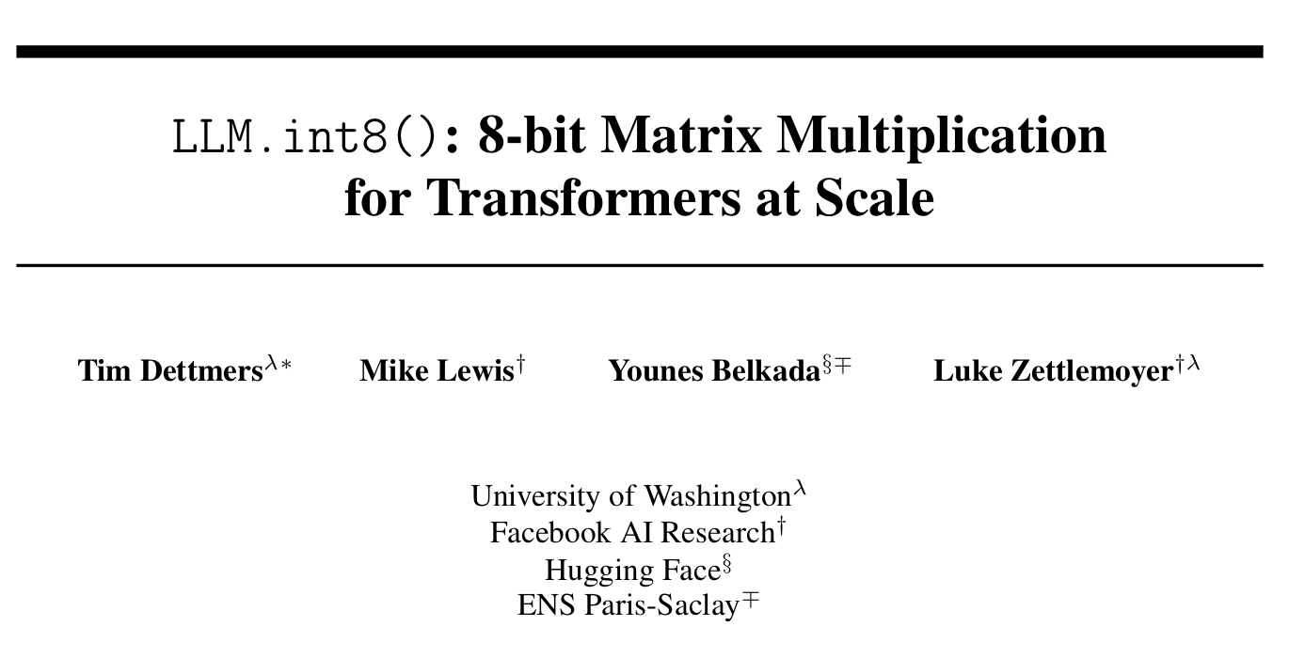
Quantisation
LLM.int8, Dettmers et al. 2022
Propose the first billion-scale INT8 quantisation for transformers that does not incur any performance degradation

Slide 13
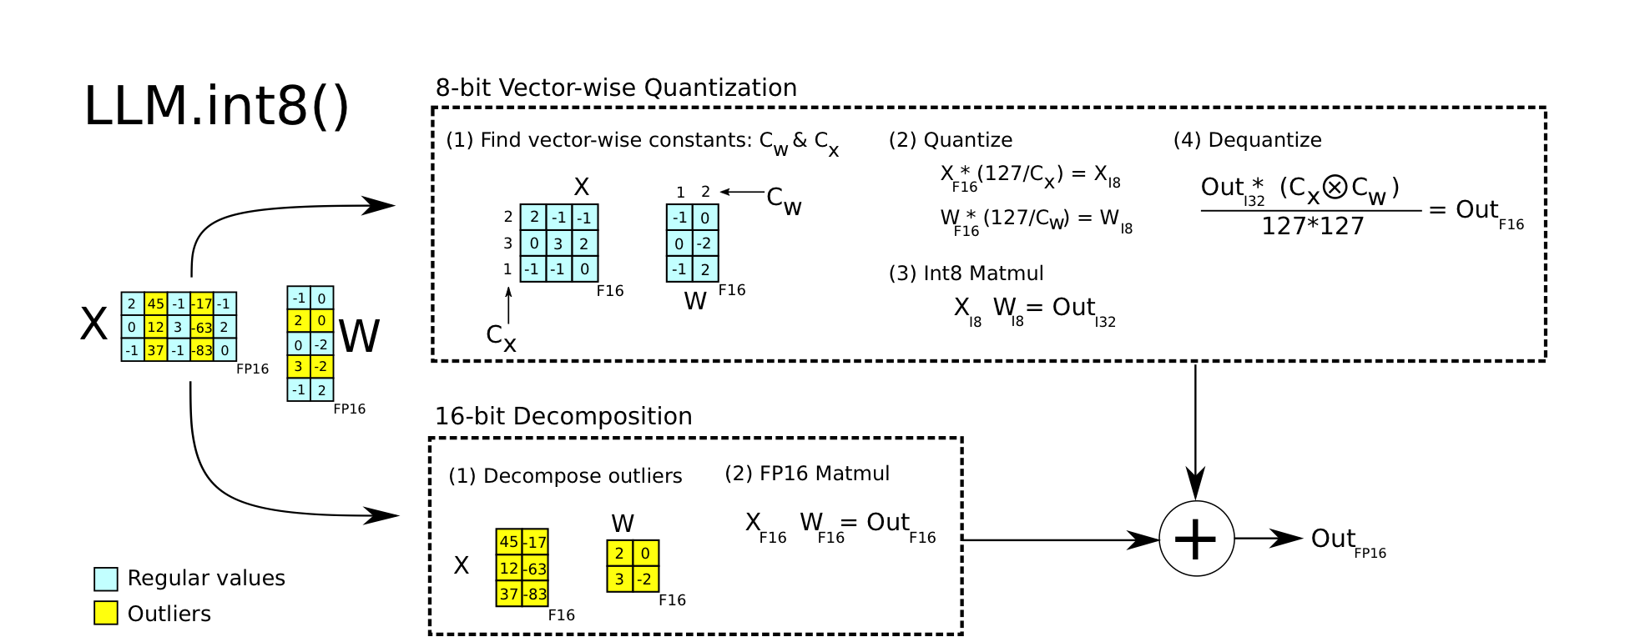
LLM.int8, Dettmers et al., 2022
Vector-wise Quantisation

Slide 14
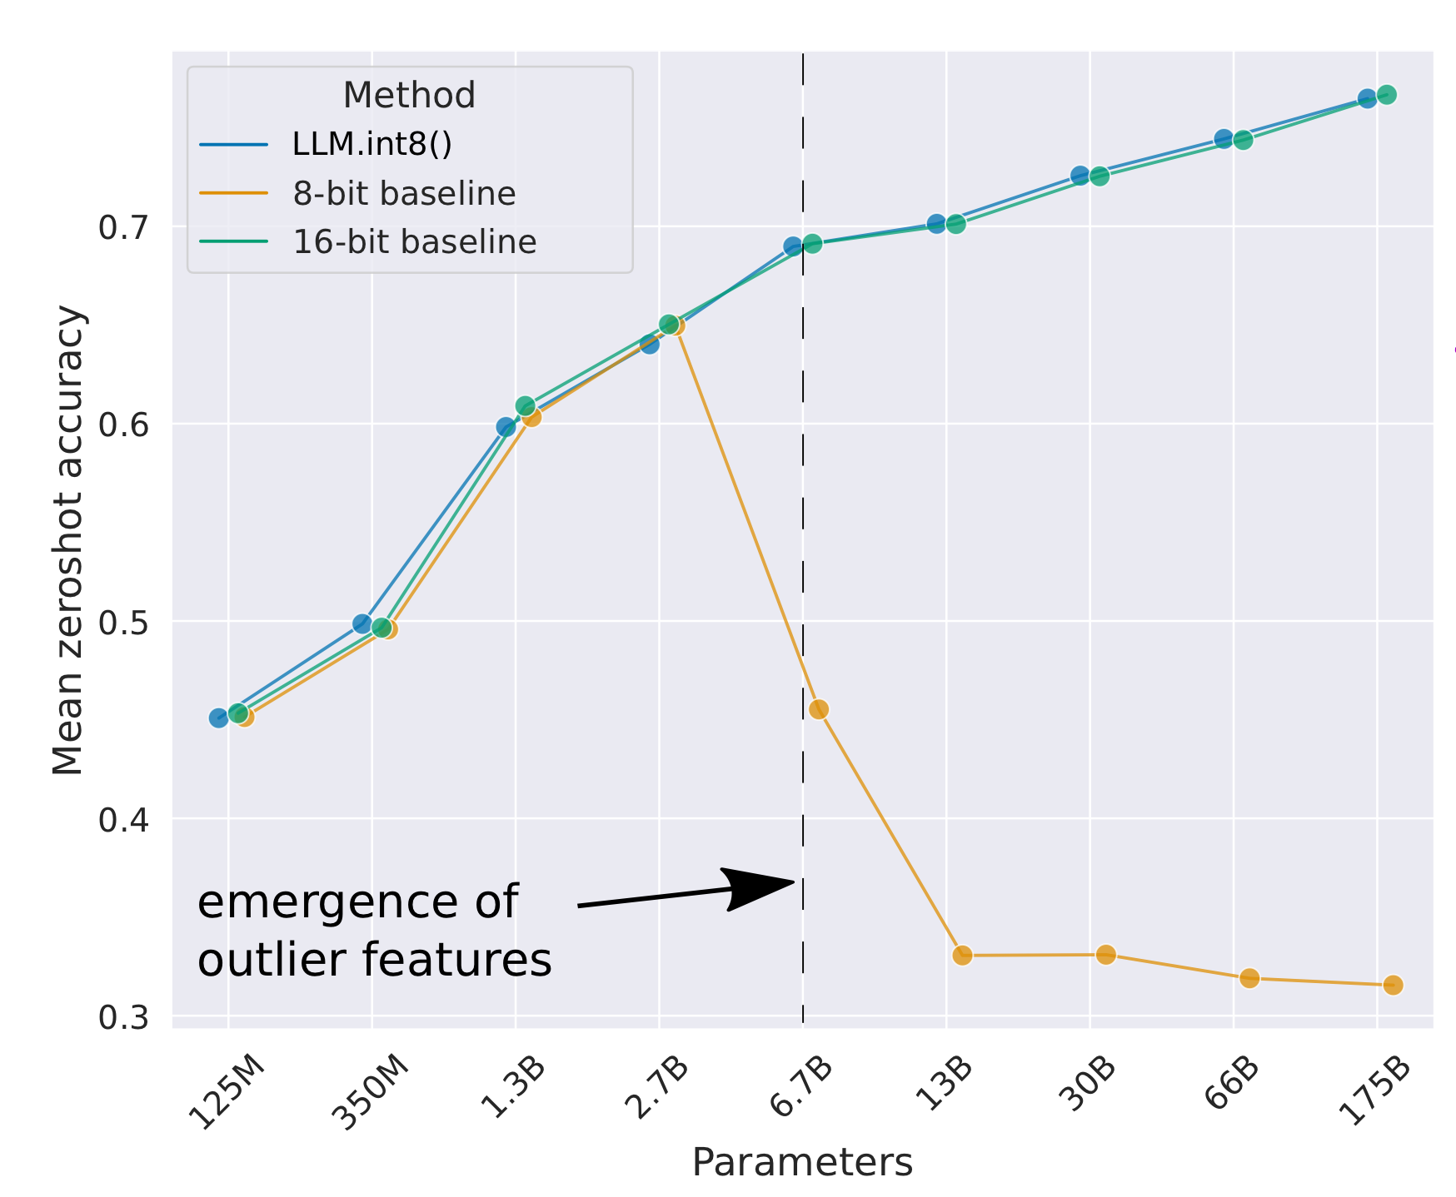
Quantisation
Emergent Outliers

Slide 15
LLM.int8, Dettmers et al., 2022
Mixed Precision Decomposition

Slide 16
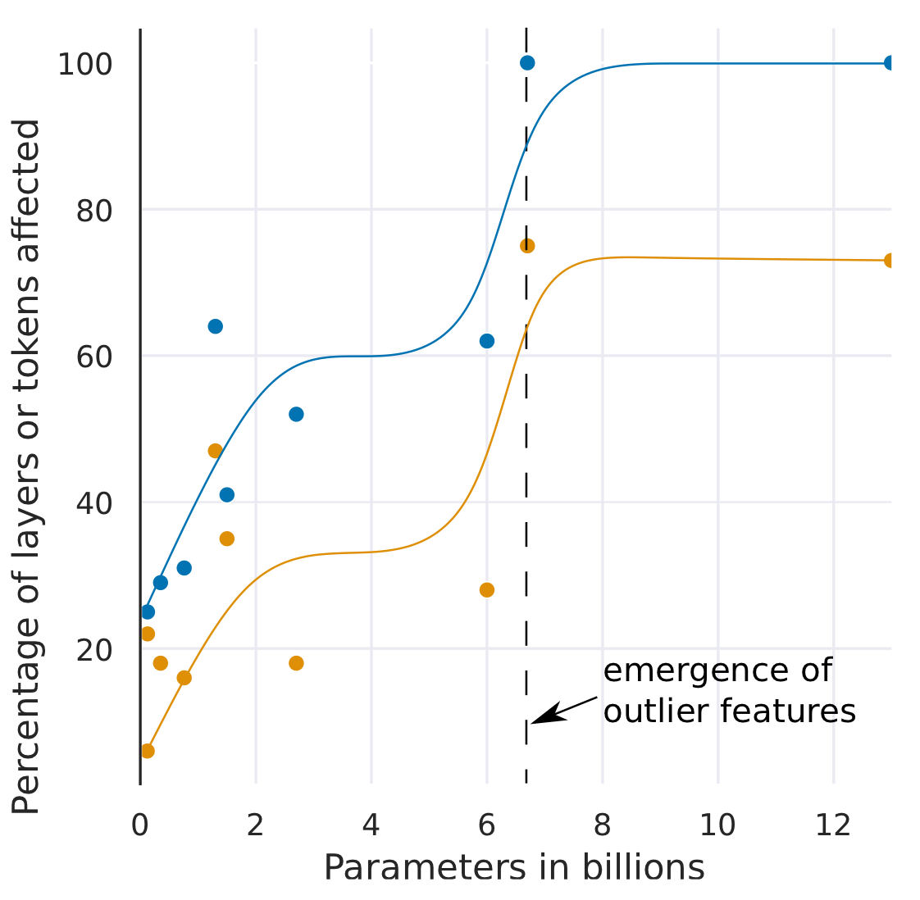
LLM.int8, Dettmers et al., 2022
Findings
The emergence of large magnitude features across all layers of a transformer occurs suddenly between 6B and 6.7B parameters.

Slide 17
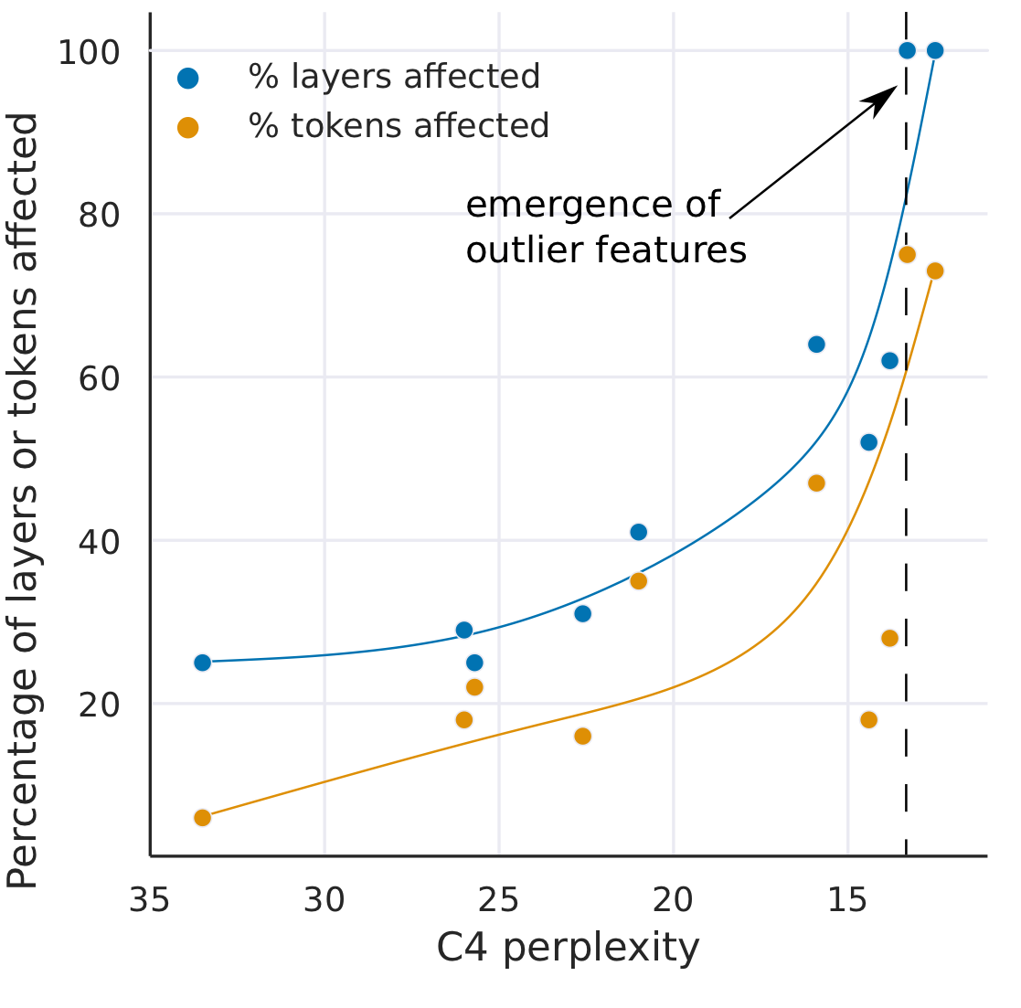
LLM.int8, Dettmers et al., 2022
Findings
However, there is nothing sudden about the emergence of large magnitude outlier features when measured by perplexity.

Slide 18
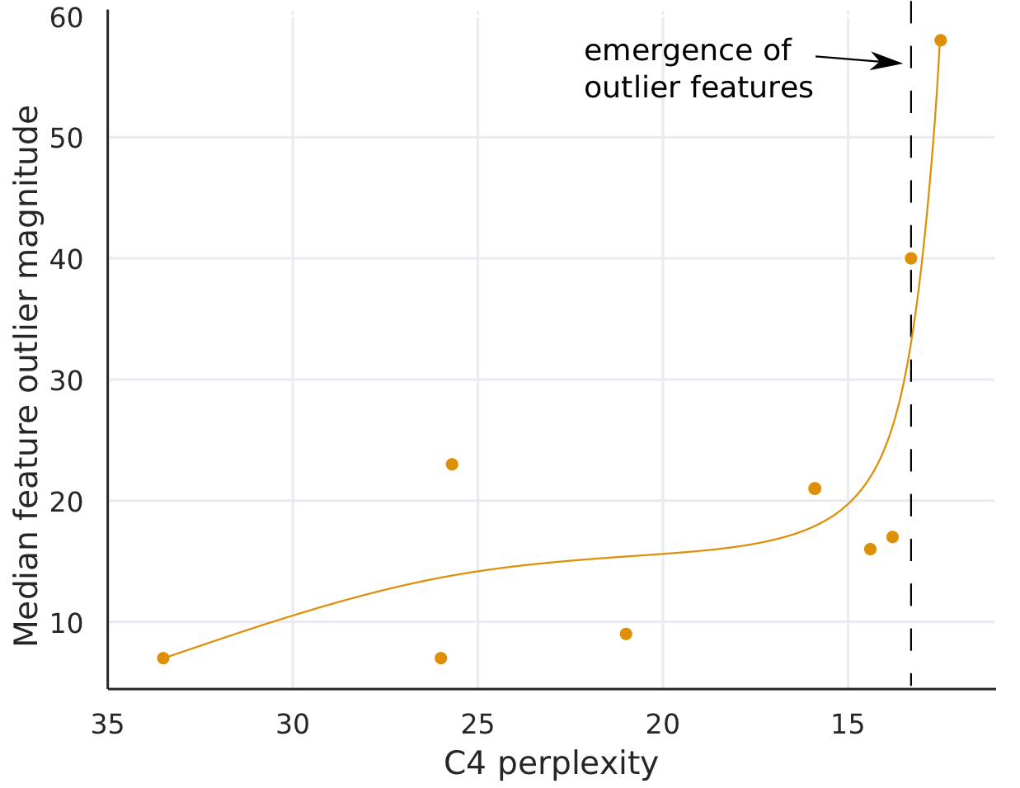
LLM.int8, Dettmers et al., 2022
Findings
The median magnitude of outlier features increases rapidly once outlier features occur in all layers of the transformer.
A core reason why quantisation methods fail after 6.7B parameters.

